Slide 1
Connecting you to your best MilLife

Slide 2
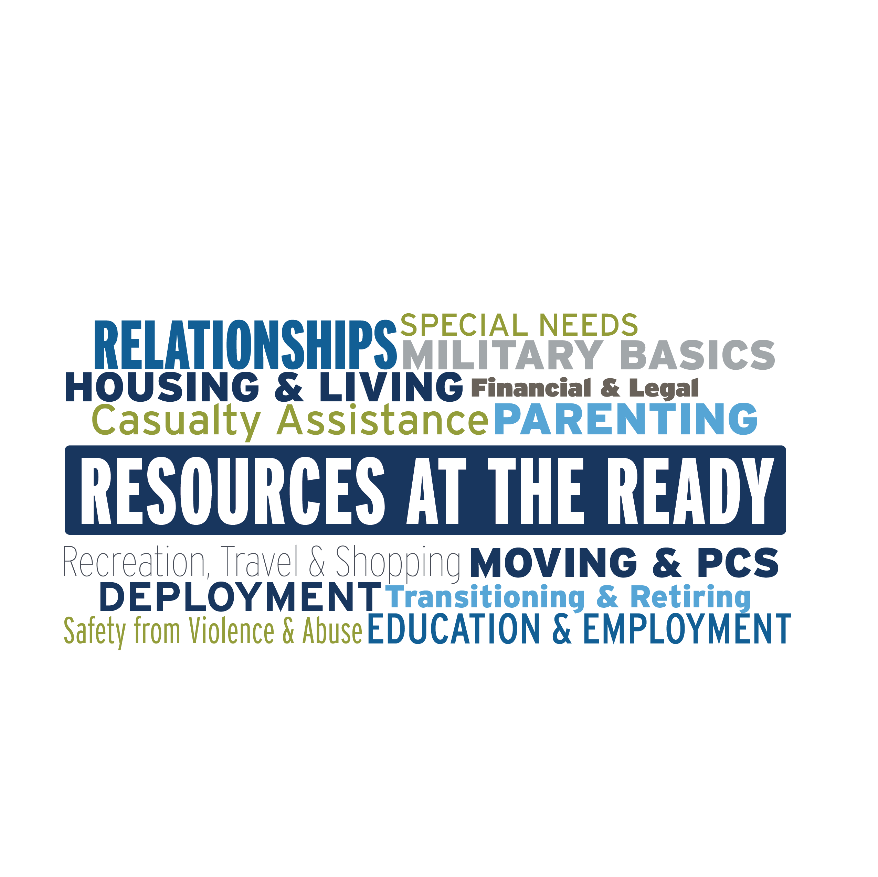
Get the help you need — when, where and how you need it.
Notes:
We offer support for all these aspects of military life.

Slide 3
One Source for Our Military Community
Personal support is available for members of our military community including:
All active duty, National Guard and Reserve Component service members, regardless of activation status
Immediate family members
Coast Guard, when activated with the Navy
Expeditionary civilians, 90 days pre- until 180 days post-deployment
Retired or discharged, honorably or a general discharge, including Coast Guard veterans, and their immediate family up to 365 days post separation or retirement
Survivors: non-remarried spouses and children
Most Digital Resources are also open to service members' friends and extended family.
Notes:
These groups are eligible for ALL Military OneSource services:
Active duty: All active-duty service members of the Army, Marine Corps, Navy, Air Force and Space Force
Active-duty immediate family members: includes spouses, children and anyone who has legal responsibility for the service member’s children during separation for the child’s benefit
National Guard and reserve service members and their immediate families: includes spouses, children and anyone who has legal responsibility for the service member’s children during separation for the child’s benefit
Coast Guard members who are activated as part of the Department of the Navy under Title 10 authority, as well as their family members
Designated Department of Defense expeditionary civilians and their families: includes spouses, children and anyone who has legal responsibility for the service member’s children during separation for the child’s benefit
Survivors (surviving spouses who have not remarried and children) of active duty, National Guard and reserve service members
Medically discharged service members and their immediate family members if they are being serviced under one of the services’ wounded warrior or seriously ill and injured programs.
Retired service members until 365 days past end of tour of service, retirement date or discharge date, including service members on the Temporary Disability Retirement List. Coast Guard veterans and their immediate family are eligible from their separation date until 365 days past end of tour of service.
Discharged service members if discharged honorably, and their immediate family members, until 365 days past end of tour of service, retirement date or discharge date. Coast Guard veterans, if discharged honorably, and their immediate family are eligible from their separation date until 365 days past end of tour of service.
Military academy cadets.
These groups are eligible for LIMITED Military OneSource support and services:
Parents and extended family members of active-duty, National Guard and reserve service members who need assistance with issues directly related to the service member or assistance on behalf of the service member
Reserve Officers’ Training Corps students
Delayed-entry recruits and future recruits and their parents and immediate family members seeking support directly related to or on behalf of the future recruit
Non-military/non-spouse (for example, partner or former spouse) who is the parent of an eligible child is eligible if the service member is being serviced under an injured soldier program as well as his or her immediate family, including anyone who has legal responsibility for a service member’s children during separation; eligibility extends to language translation services for documents and telephone translation

Slide 4
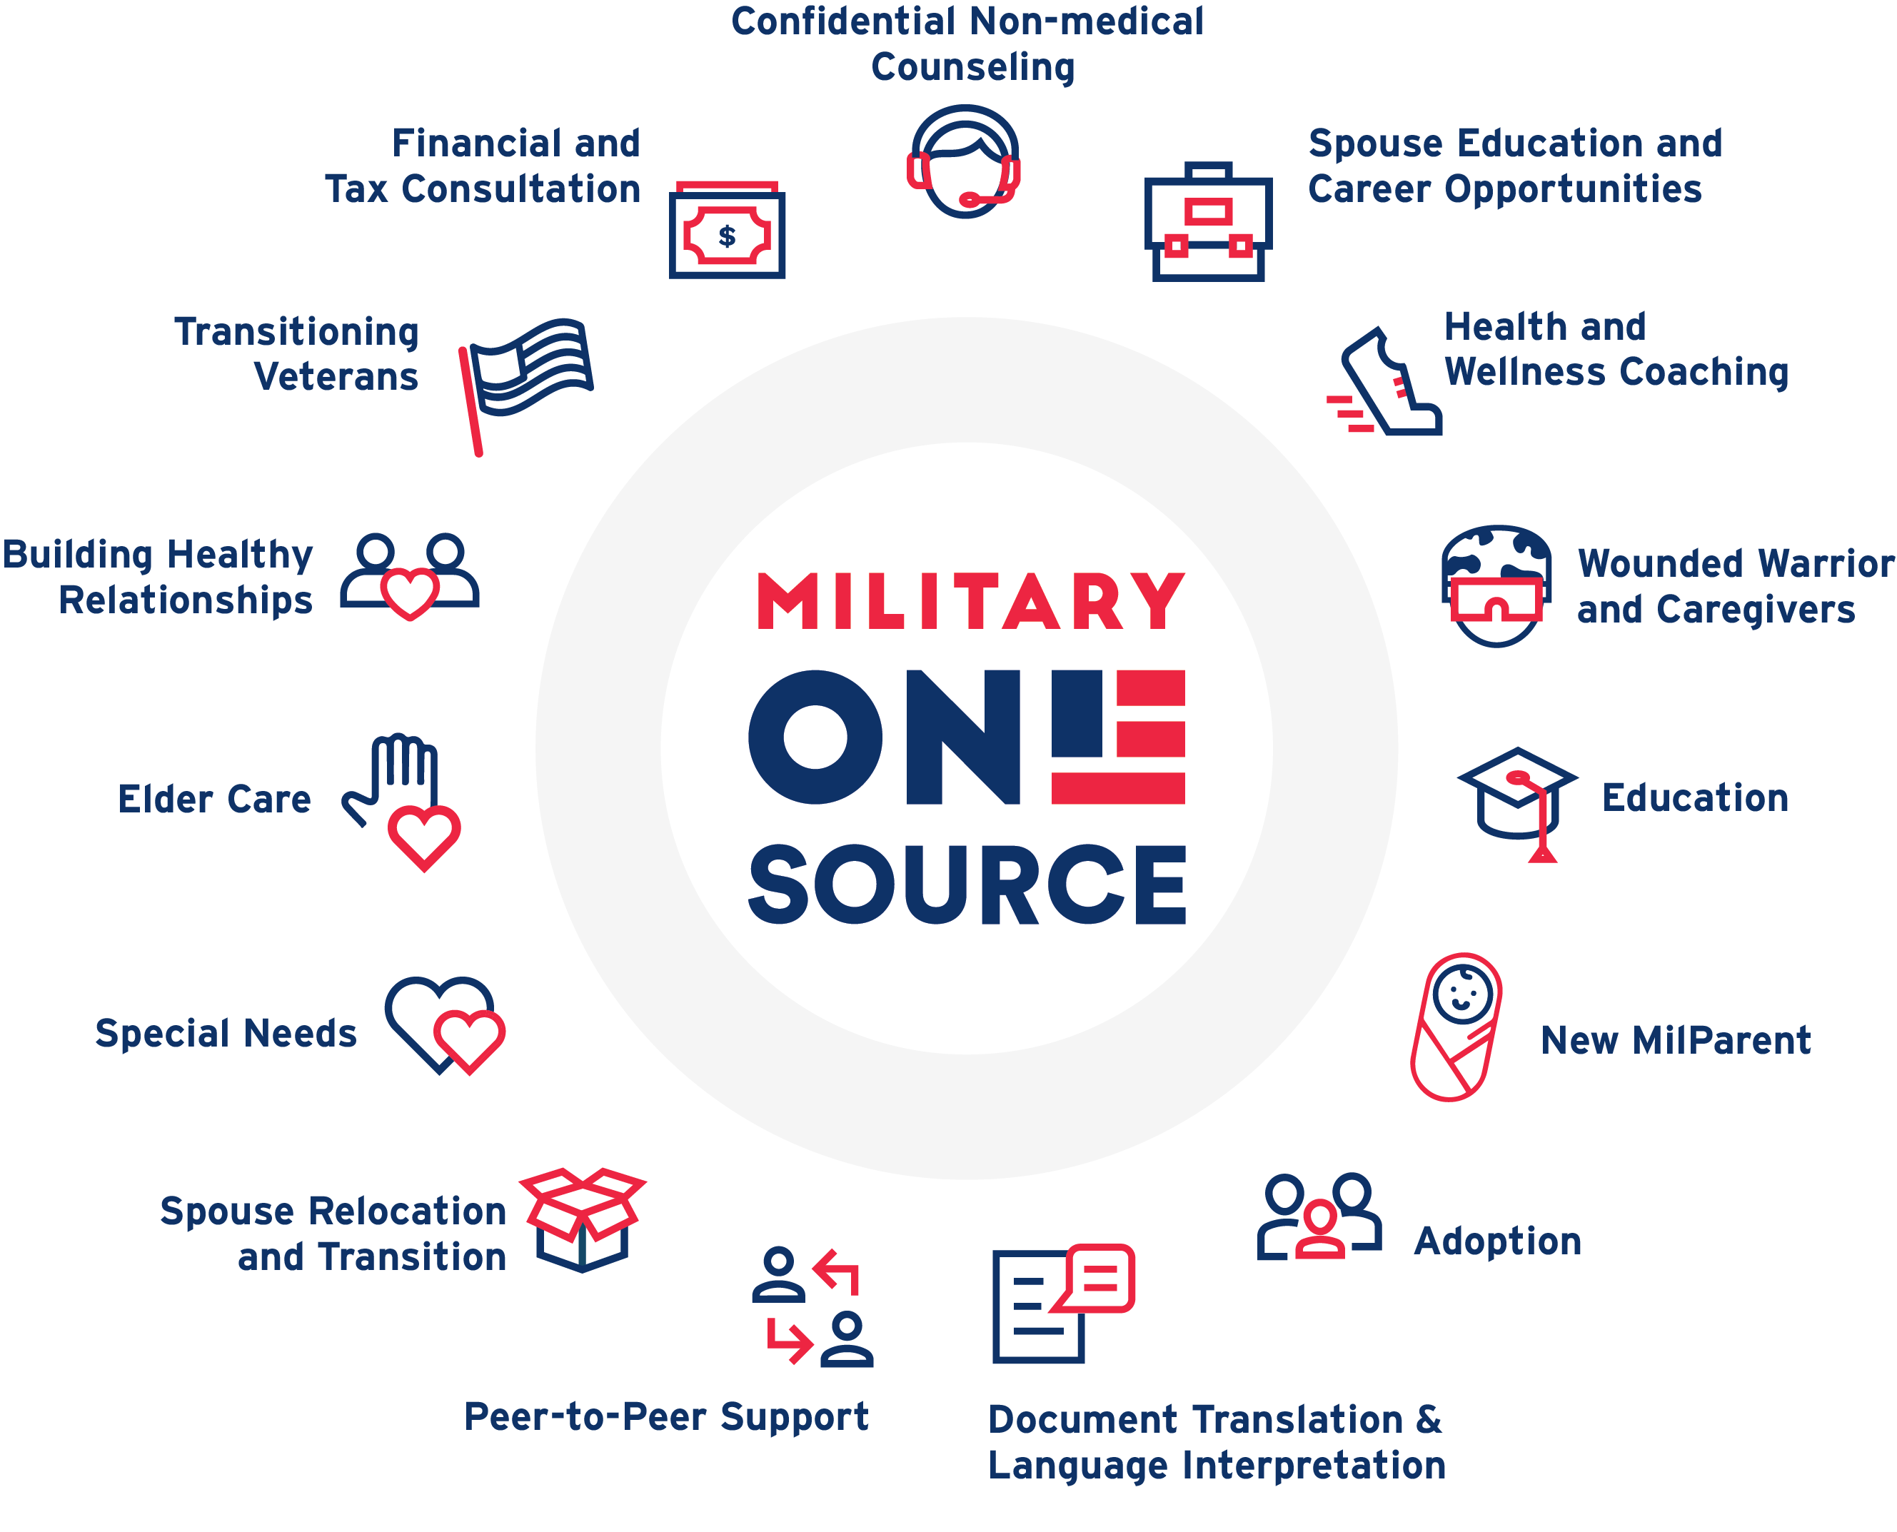
All consultations and services are just a phone call or chat away. Need other support? We can connect you!
Notes:
Military OneSource connects service members and their families to a range of support for military life
This list is a sampling of the different areas we can help with; reach out or visit the website to explore more. If you need personal support on an issue that’s not addressed here, you can still feel free to contact us. We can arrange to connect you with the right help.

Slide 5
Confidential Non-medical Counseling
Military OneSource:
Face-to-face, online, by phone and video sessions
Short-term, up to 12 sessions, per issue
Video sessions now available to children and teens in addition to face-to-face
Military and Family Life Counseling:
Face-to-face counseling and presentations in a variety of locations:
Military and family support centers
Child development centers
School and youth camps
Embedded in military units
Targeted “surge” locations
Notes:
New MilParent Get pro support and resources to help with:
Sleep issues
Toilet training
Managing difficult behaviors
Solo parenting
Finding child care
Understanding stages of development
Supporting early childhood development
And more!
Adoption
Get one-on-one help from an expert to:
Understand the different types of adoptions
Identify agencies that can help you with your specific adoption needs
Find information and referrals to state or county licensed agencies, the Department of Child and Family Services, and/or the Department of Health and Human Services
Understand state-specific adoption and foster care requirements
Understand the state-specific adoption and foster care processes including home studies, the length of time the process takes and associated costs
Locate military-related financial assistance
Begin the foster care or adoption process
Find support groups and helpful literature
Special Needs Get one-on-one help to:
Understand the benefits and resources available to your family through the Exceptional Family Member Program and TRICARE
Connect with an expert in special education
Take care of financial and estate planning
Learn how to access a range of resources and benefits
Elder Care Get personalized help to:
Understand and access benefits from the VA and Medicaid
Find in-home care and facilities
Get referrals for different support programs

Slide 6
Child & Youth Military & Family Life Counseling
Child & Youth (CYB) MFLC Counselors are the subject matter experts on developmental, milestone and emotional needs of the military child.
Child & Youth MFLCs help with:
Self Esteem
Bullying
Behavioral Problems
Deployment & Reintegration
Relationships (including divorce)
Grief and Loss
Problem Solving
Notes:
New MilParent Get pro support and resources to help with:
Sleep issues
Toilet training
Managing difficult behaviors
Solo parenting
Finding child care
Understanding stages of development
Supporting early childhood development
And more!
Adoption
Get one-on-one help from an expert to:
Understand the different types of adoptions
Identify agencies that can help you with your specific adoption needs
Find information and referrals to state or county licensed agencies, the Department of Child and Family Services, and/or the Department of Health and Human Services
Understand state-specific adoption and foster care requirements
Understand the state-specific adoption and foster care processes including home studies, the length of time the process takes and associated costs
Locate military-related financial assistance
Begin the foster care or adoption process
Find support groups and helpful literature
Special Needs Get one-on-one help to:
Understand the benefits and resources available to your family through the Exceptional Family Member Program and TRICARE
Connect with an expert in special education
Take care of financial and estate planning
Learn how to access a range of resources and benefits
Elder Care Get personalized help to:
Understand and access benefits from the VA and Medicaid
Find in-home care and facilities
Get referrals for different support programs

Slide 7
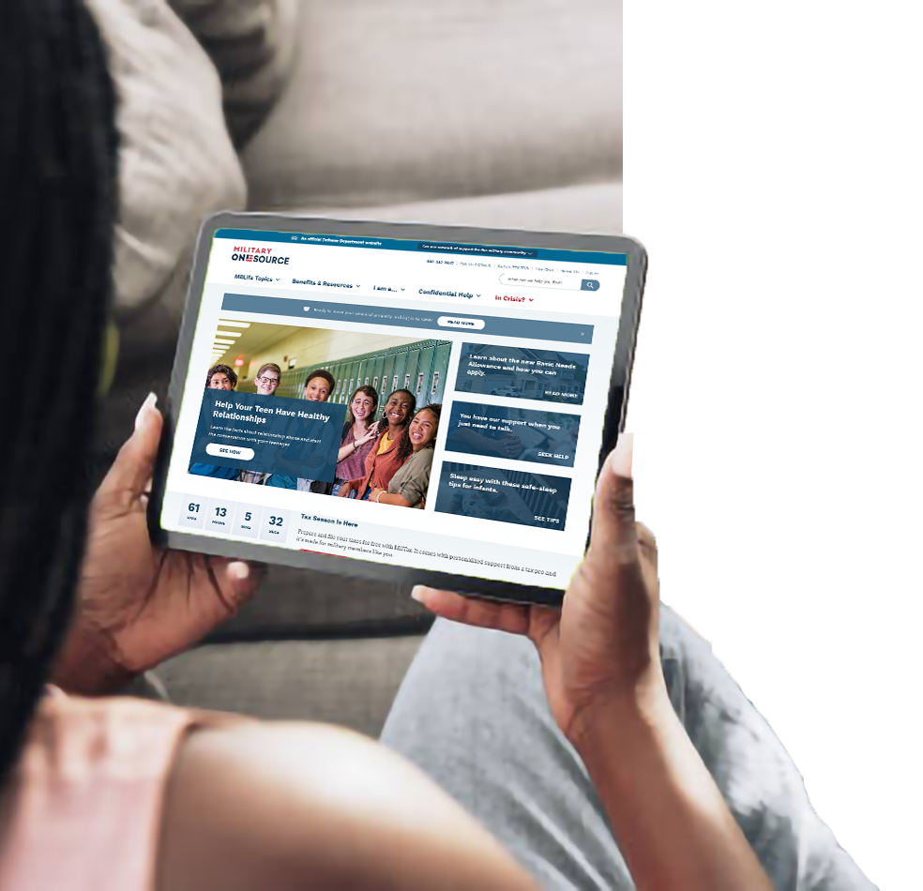
MilitaryOneSource.mil
Your direct source for news, info, answers and updates on programs and benefits to support your MilLife.
Covers military life basics, PCS and moving personal property, updates to Basic Needs Allowances, tools for retirement, expanding parental leave, personal safety and domestic violence prevention tools, and more
Find quick answers to questions
Fast links on where/how to access your benefits
Set up Live Chats or Click to Call and talk to someone

Slide 8
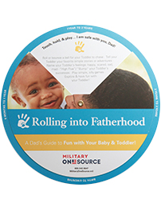
More Resources
The MilProvider App gives service providers quick and easy access to find and share trusted products and resources with those they support.
Expanded childcare options offer free access to a national database of more than a million caregivers to find hourly, flexible, and on-demand childcare.
Chill Drills allow you to practice mindfulness and relieve stress with a collection of simple audio recordings available 24/7.
Products for order or download that cover a range of topics, to include relationships, health and wellness, deployment, parenting, non-medical counseling, and more.

Slide 9
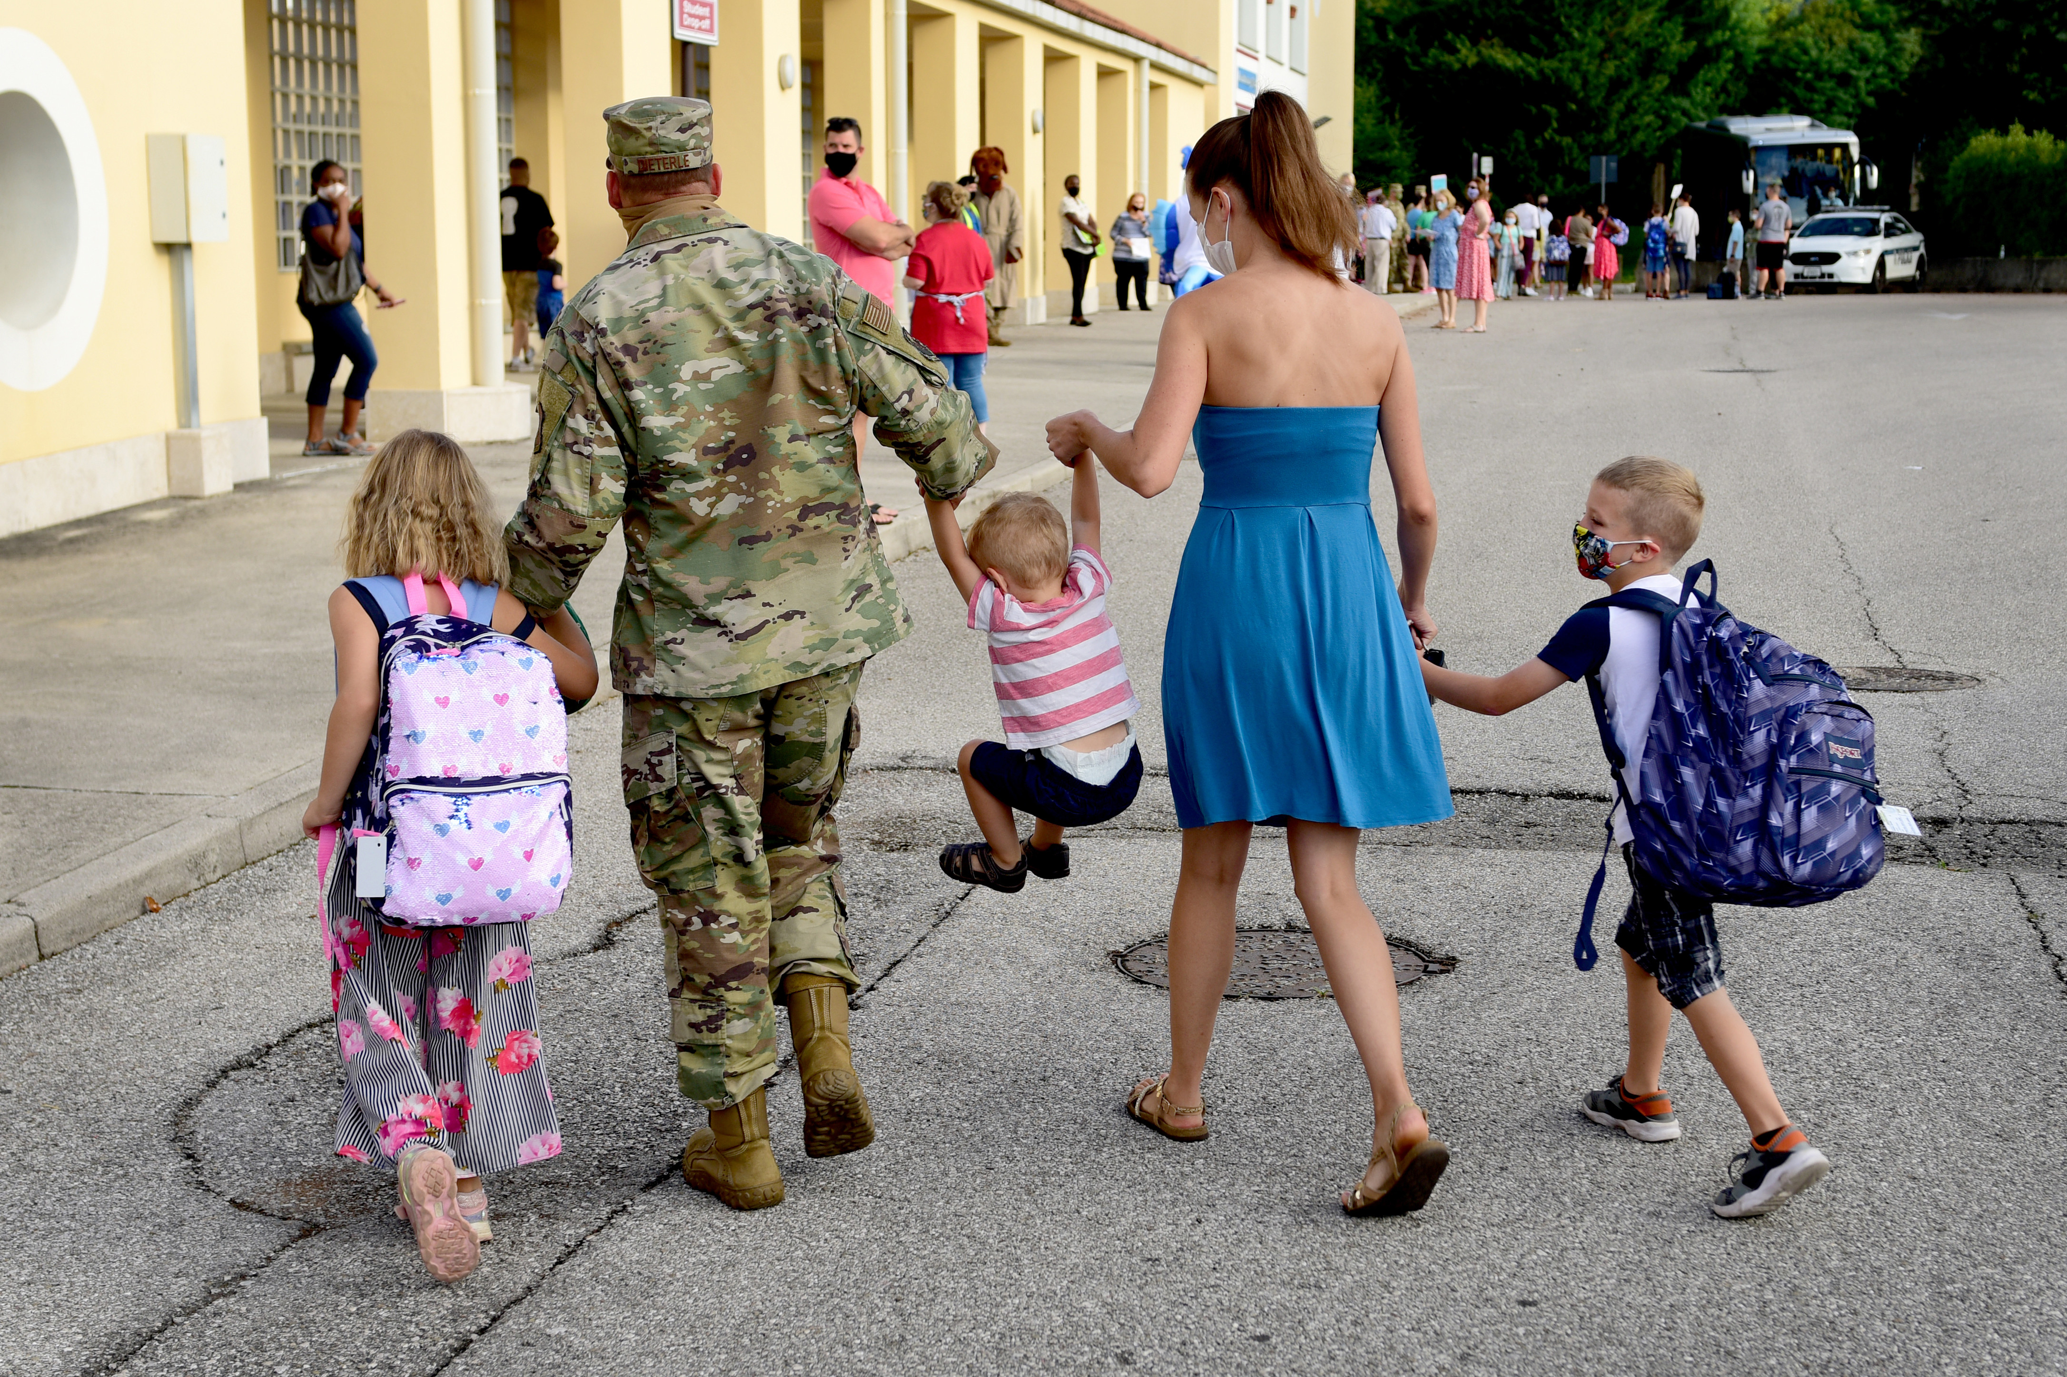
Access our support when, where and how it's convenient for you.
Call 800-342-9647
Live Chat
My Military OneSource App
Charlene A. Sanchez
Associate Director, Military Community Support Programs
Program Manager, Military OneSource
Charlene.a.sanchez.civ@mail.mil
MilitaryOneSource.mil
Notes:
Connect to Military OneSource and personalized support 24/7. You can call, CONUS or OCONUS, arrange a live chat, download the app for easy access on your phone.
And stay up to date by signing up for our newsletters and joining us on social media.
Social Networks
Find Military OneSource on:
Facebook
Twitter
Instagram
LinkedIn (SECO / MSEP)
Pinterest
YouTube

